Slide 1
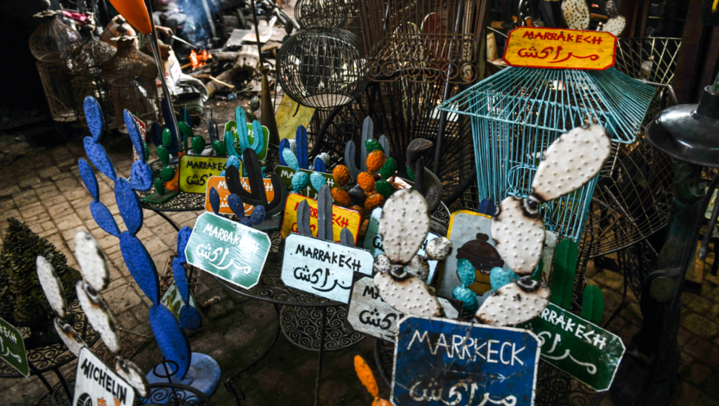

Slide 2
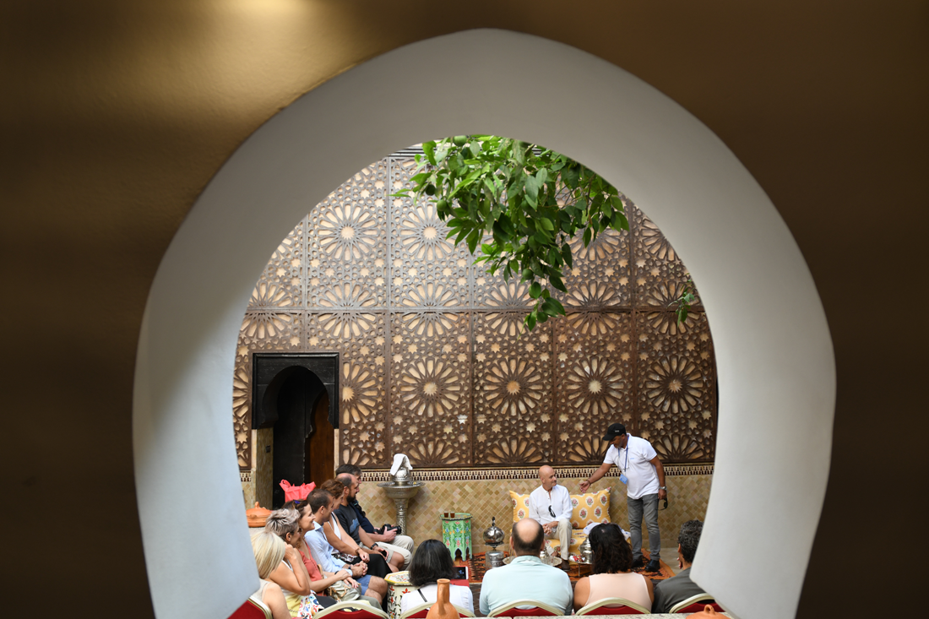
VIDEO
Imagine discovering the most interesting of the ancient city by forming groups and enjoying with your clients team.
Do you dare?

Slide 3
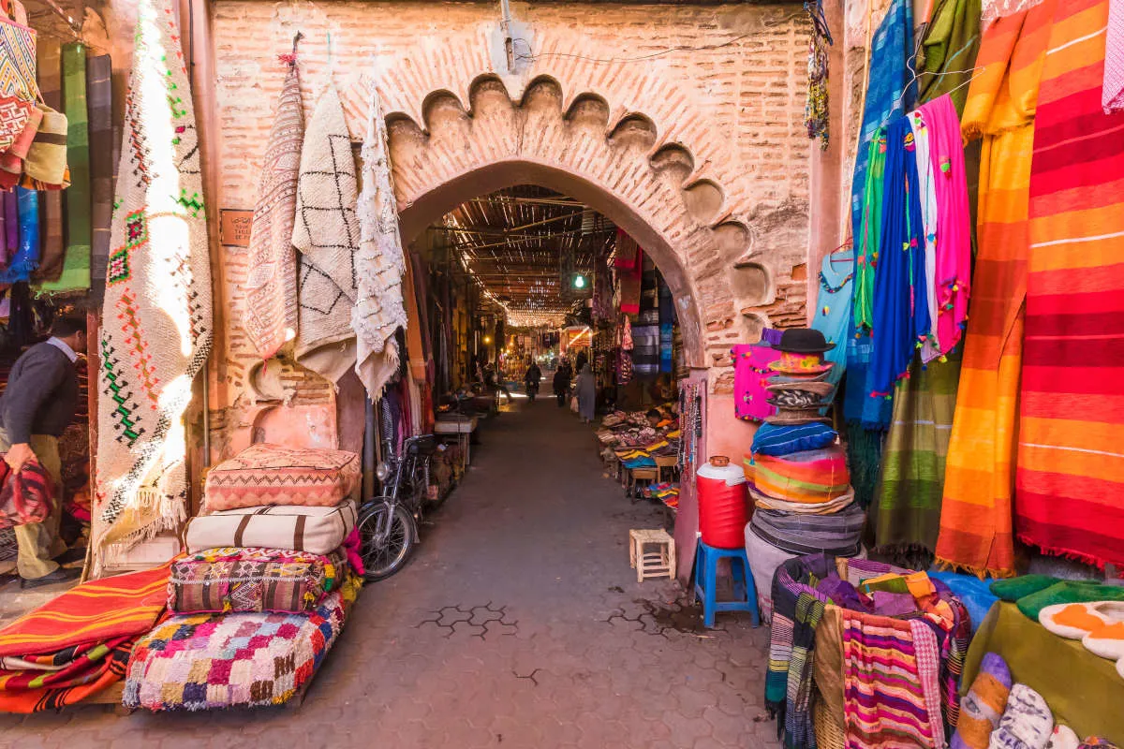
Transfer from the hotel to the deepest of the medina of Marrakech where you will have the opportunity to make a visit of the wonders that are inside. Sheherezade liked to perform different rituals or visit places of this medina and this is a tour of some of them that will make customers relive those moments that lived the most beautiful in the East. The tour is made up of :
The Essence Tea Ceremony
Lamp of Aladdin
La Baraka
They are accommodated in one of the terraces with that famous square where you can see sunset in this place, an incredible show of lights, noise and smoke that give off the large number of food stalls. After a magical moment in this place head by coach towards the hotel, and arrival at the exclusive nomadic Vivac.

Slide 4
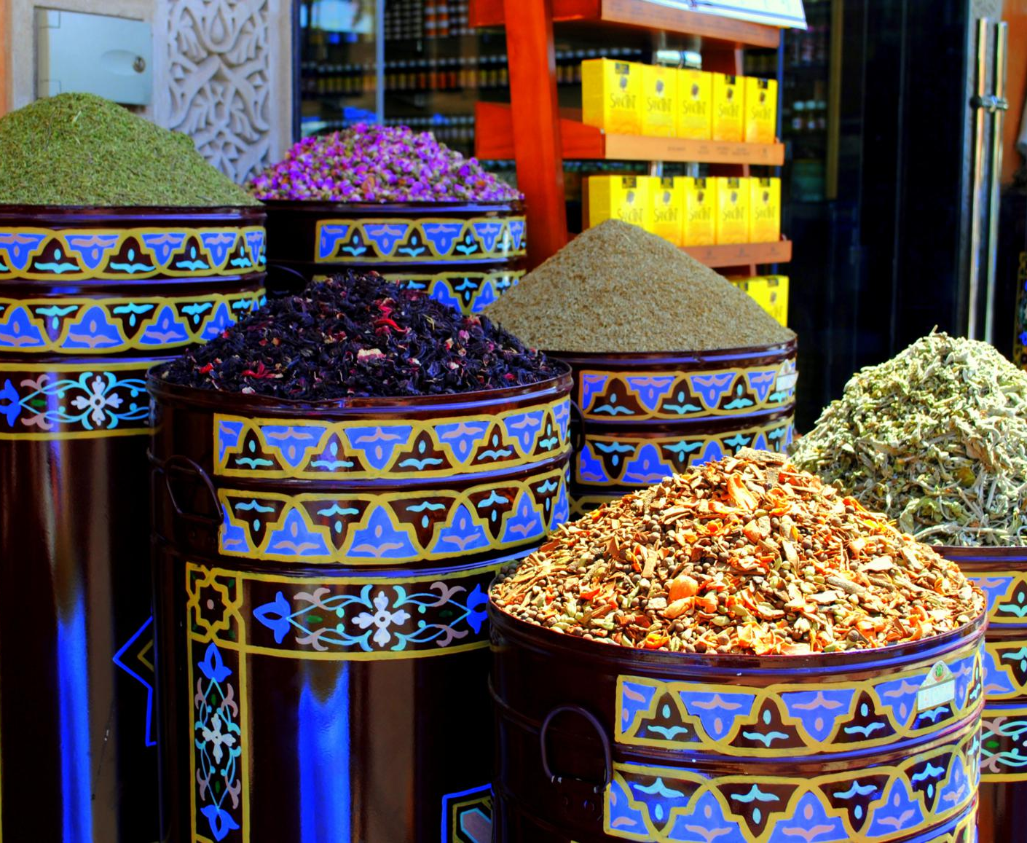
You will go to the spice district, where any corner is magical, where the remedies used are ancient and where you can discover the essence of Sheherezade. After knowing first-hand the remedies they use in deep Morocco for everyday life, customers will discover the essence they will take home as a souvenir, the essence that makes Sheherezade a special woman.
Sheherezade drew her body with Henna and in this place everyone can draw what they want through several women that will make this experience unique. Here they receive a gift from a spice rack loaded with Ras el Hanout, a mixture of 22 spices that will make the skewers at home taste different.

Slide 5
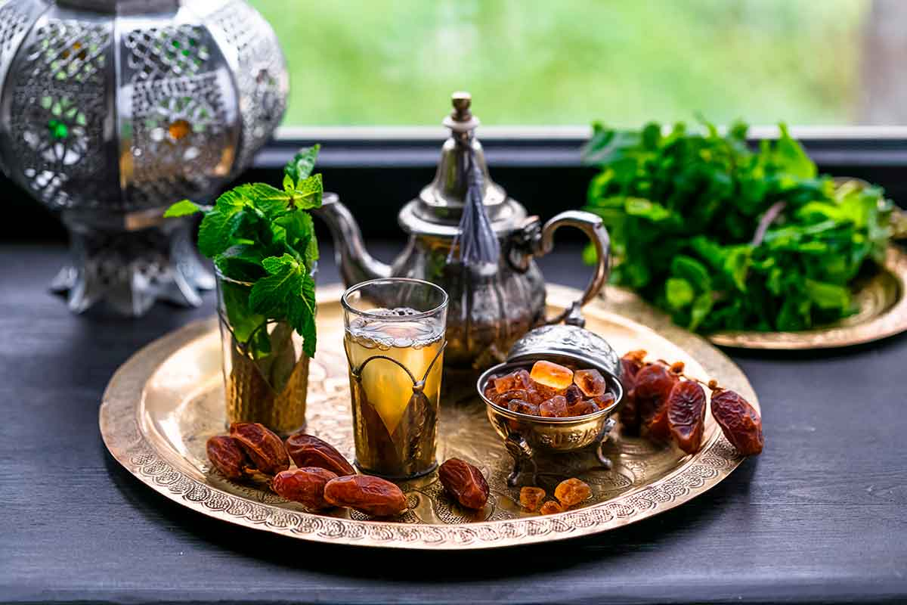
TEA
CEREMONY
Sheherezade frequented small palaces of wealthy people of the city, these palaces became Riads today and in such palaces can experience the Tea Ceremony. This ceremony is an authentic rite and an art that you need to learn to perfection to be able to then perform it at home The correct mixture of tea, sugar and mint will make such drinks perfect. They receive a game with teapot and glasses with which to do it at any time.

Slide 6
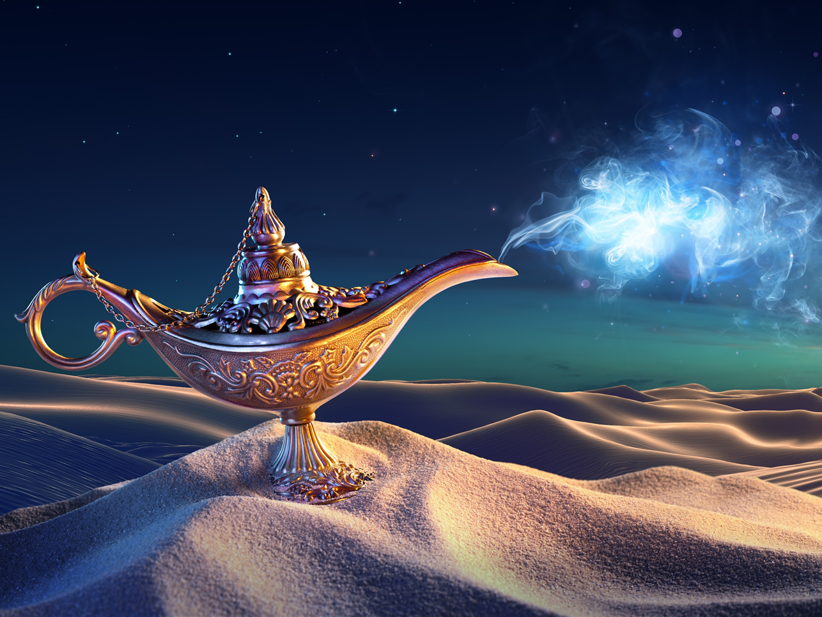
MAGIC LAMP
Aladdin managed to get a bronze lamp rubbing the genie to come out and grant him 3 wishes.
Once in the goldsmiths' quarter you can see how the artisans of this area make all kinds of wrought iron objects.
They receive a hand of Fatima carved to always remember the passage through this place.

Slide 7
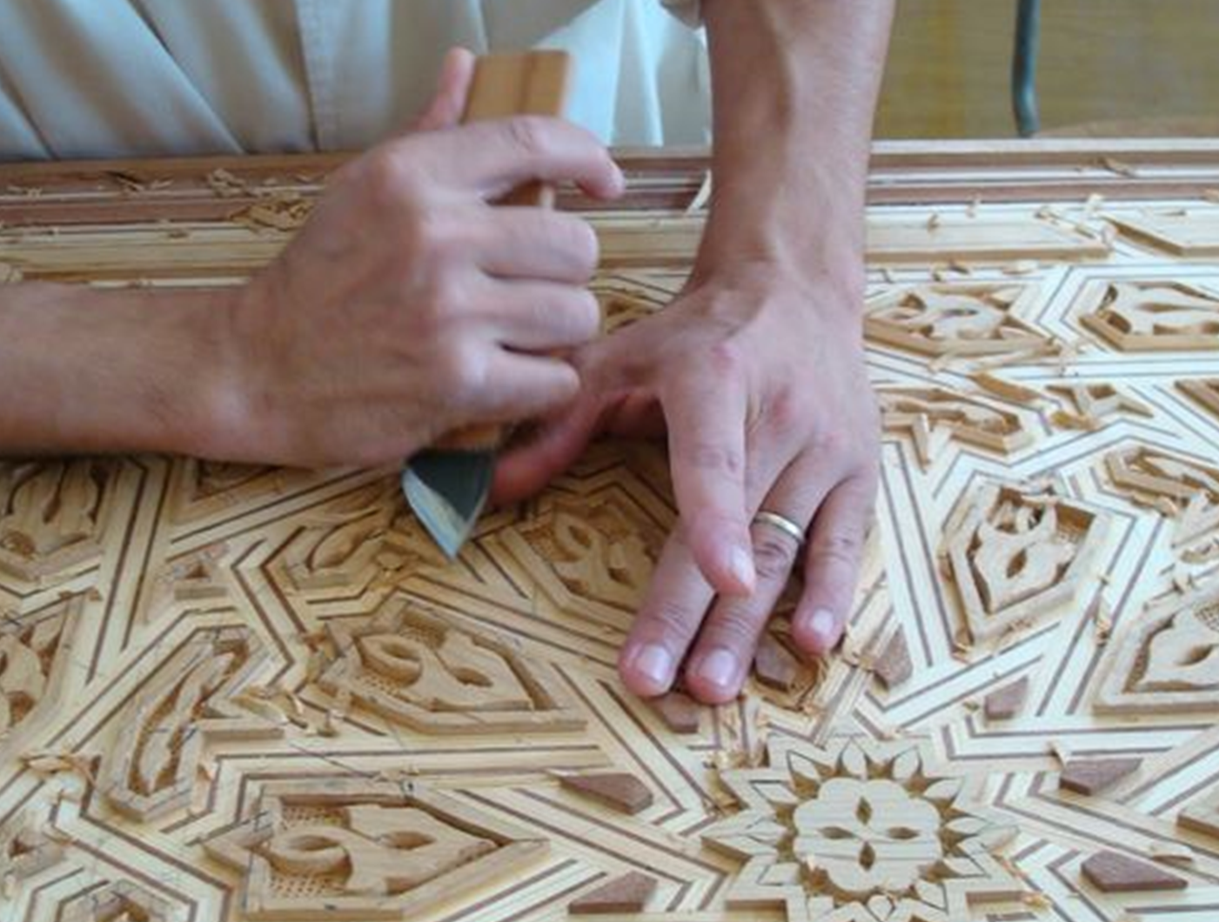
The artisans of wood carving are very curious because they are made with a lathe that moves with the action of the artisan’s feet.
The carvings they make are impressive and of great value, Sheherezade used to go to one of these workshops to buy decoration for his palace.
One of the carvings they make in a few minutes is called La Baraka, the fortune in Arabic, so customers will receive from these artisans their own Baraka that will make them have the desired luck. After contemplating the artisan carving the Baraka, they receive a copy of it as a gift.

