Slide 1
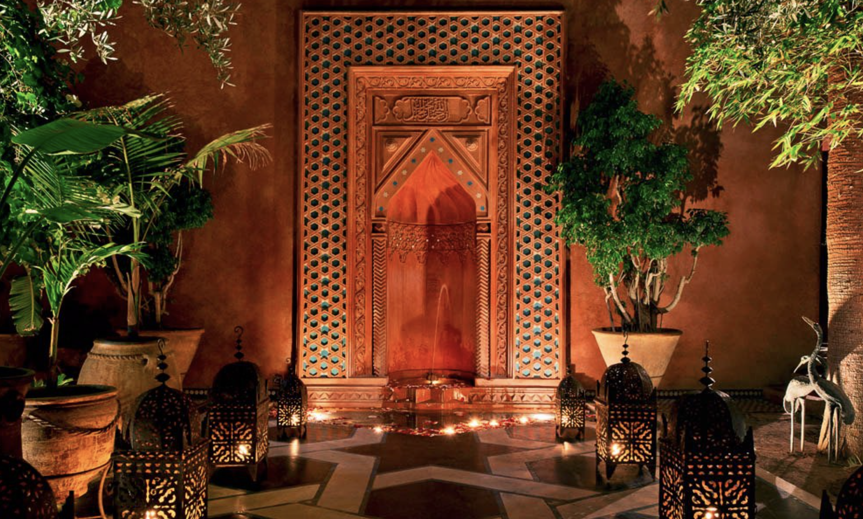

Slide 2
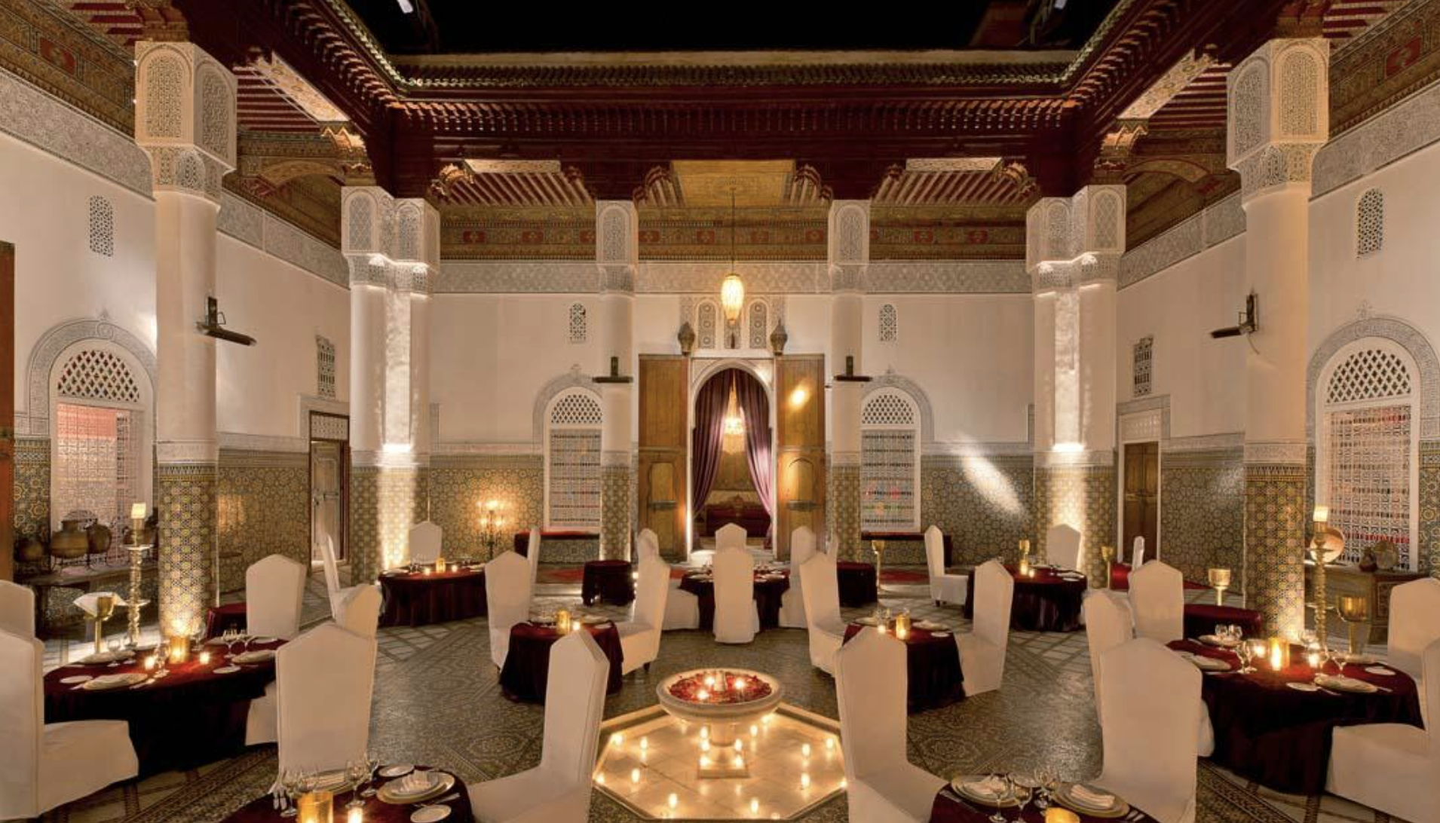
This incredible palace belonged to one of the last great lords of Marrakech: the Caïd Layadi. The Soleiman Palace is incredibly beautiful: carved ceilings and walls, mosaic walls and zelijs. The different dining rooms are magnificent. The cuisine is mainly Moroccan, with some international dishes. A small show of oriental dancers, gnawa and Andalusian duo will animate the evening. Marrakech Best Of Tip: Your Moroccan dishes are simply excellent.

Slide 3
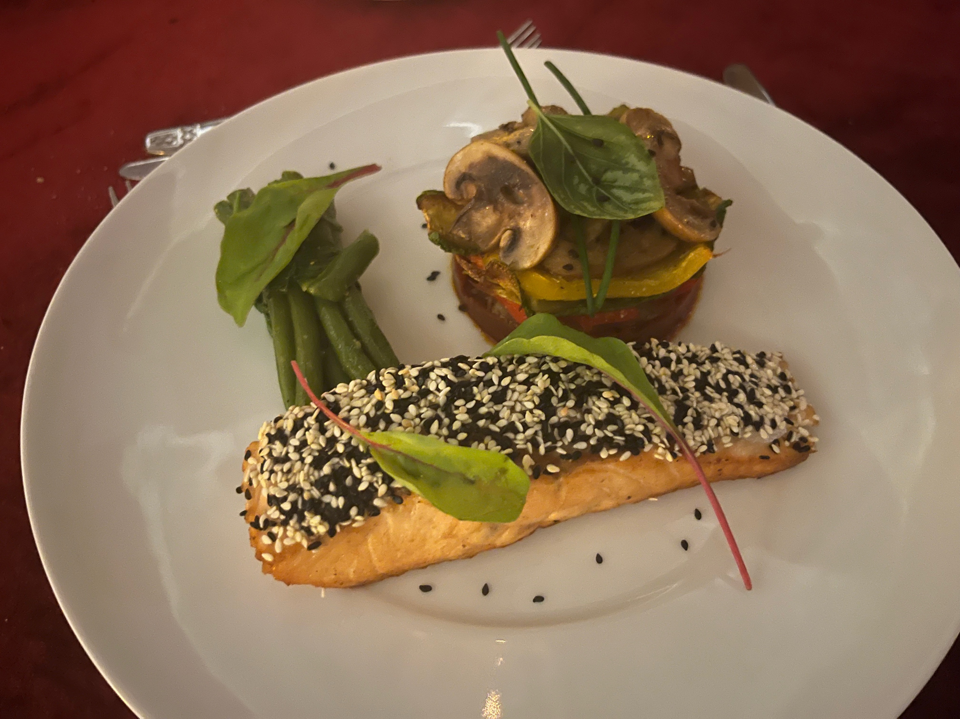
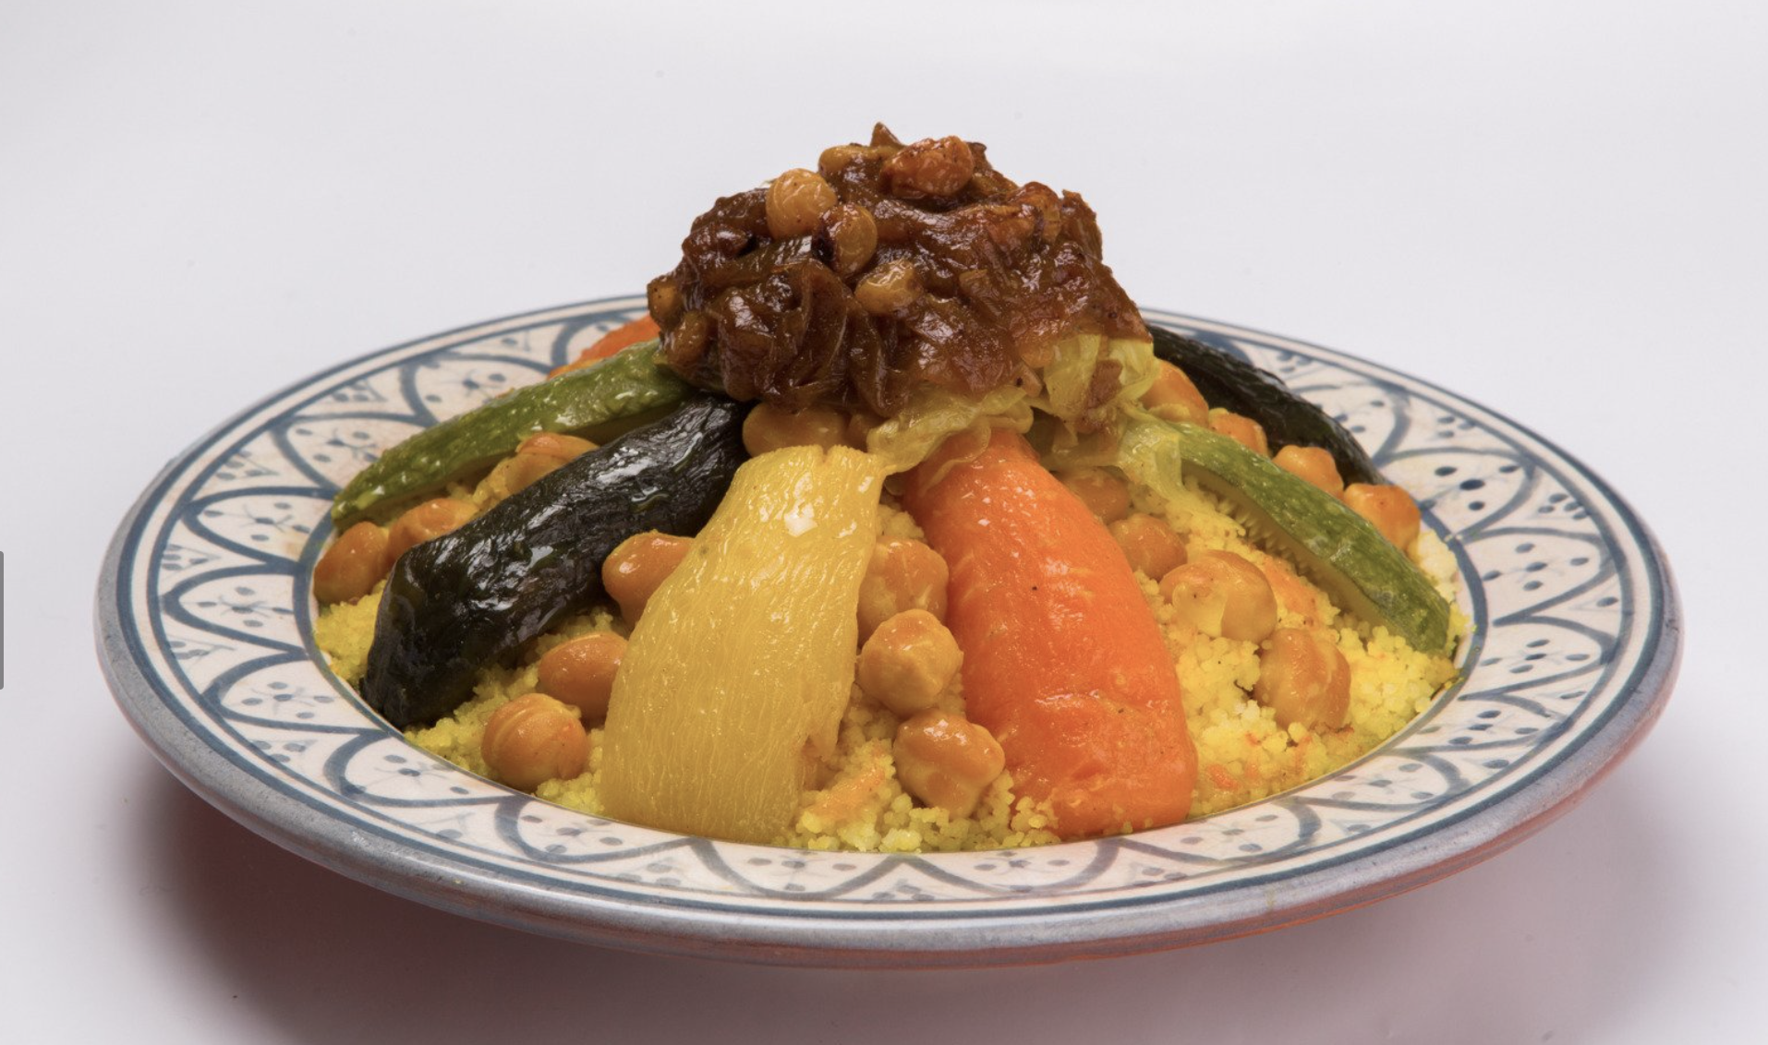

Slide 4
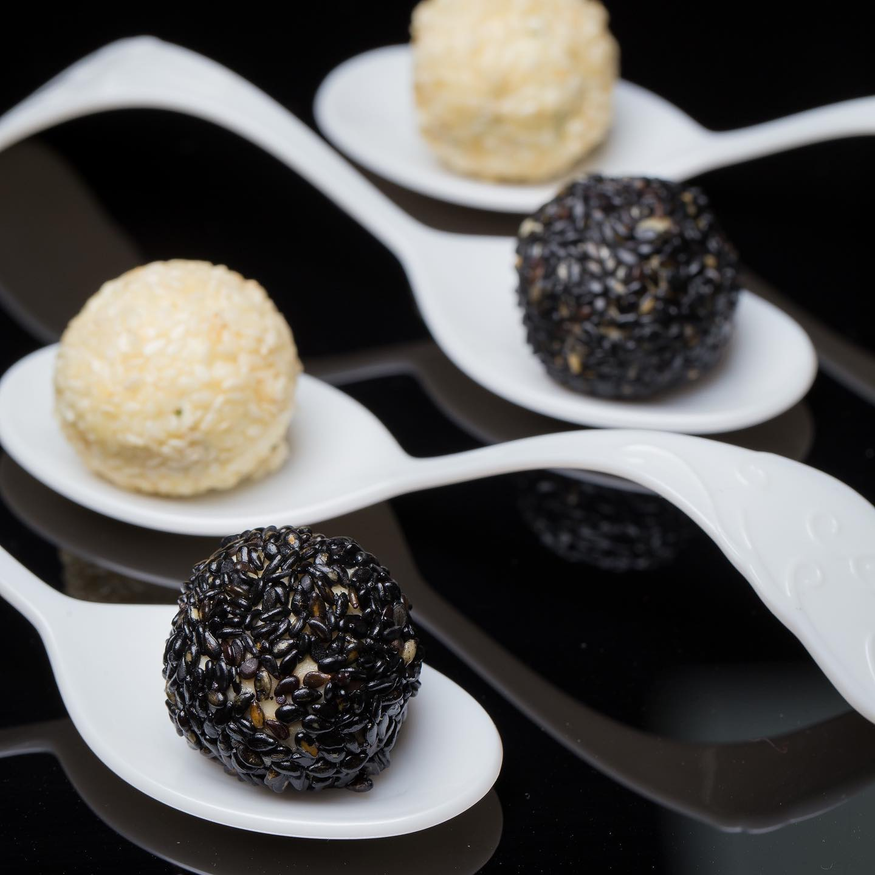
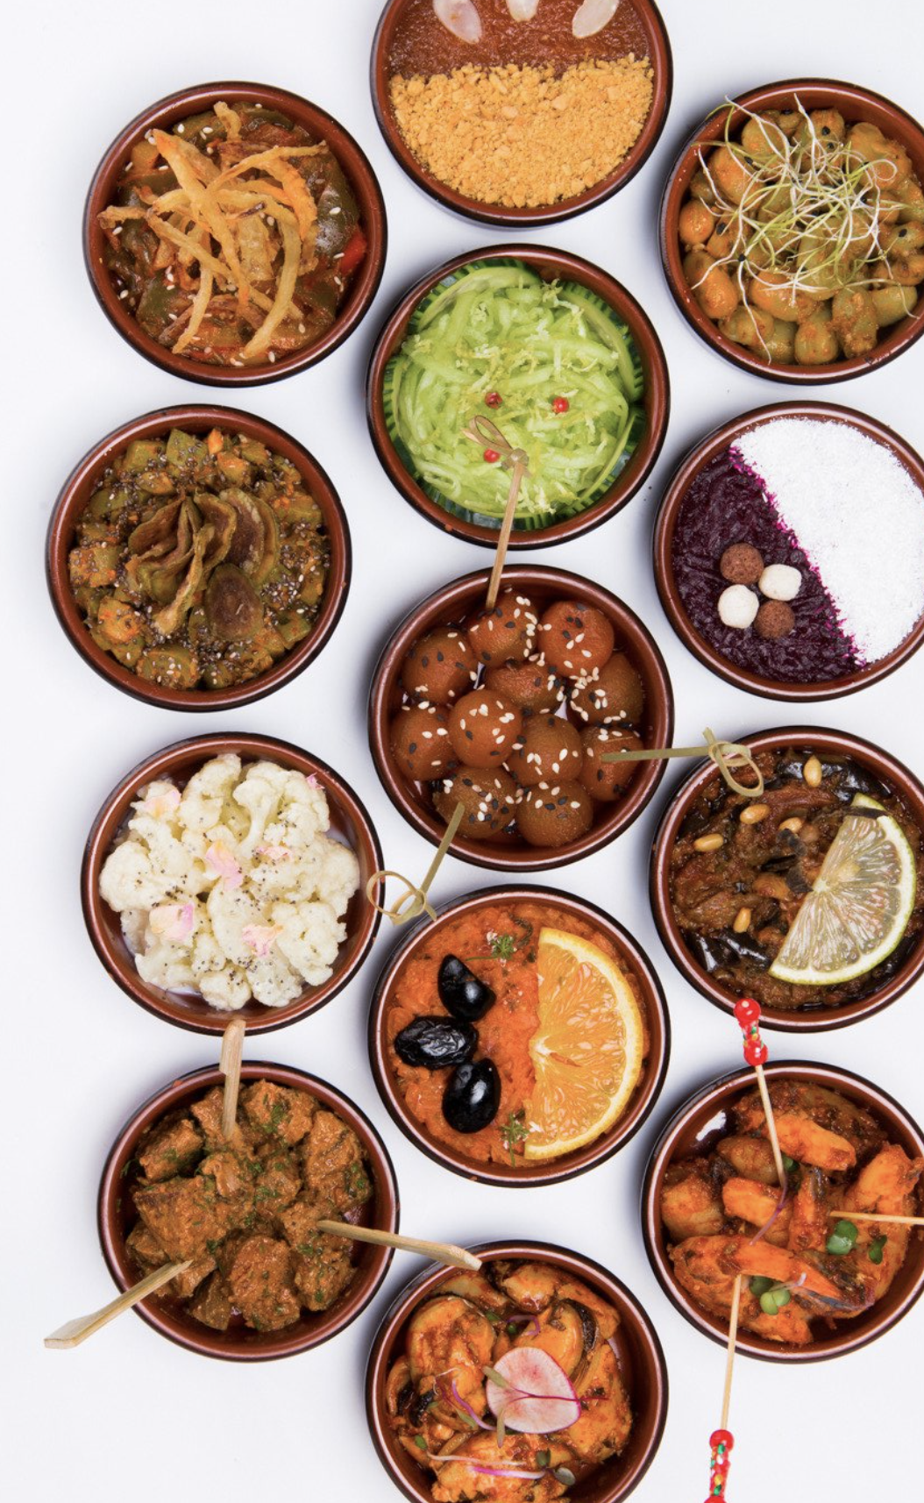

Slide 5
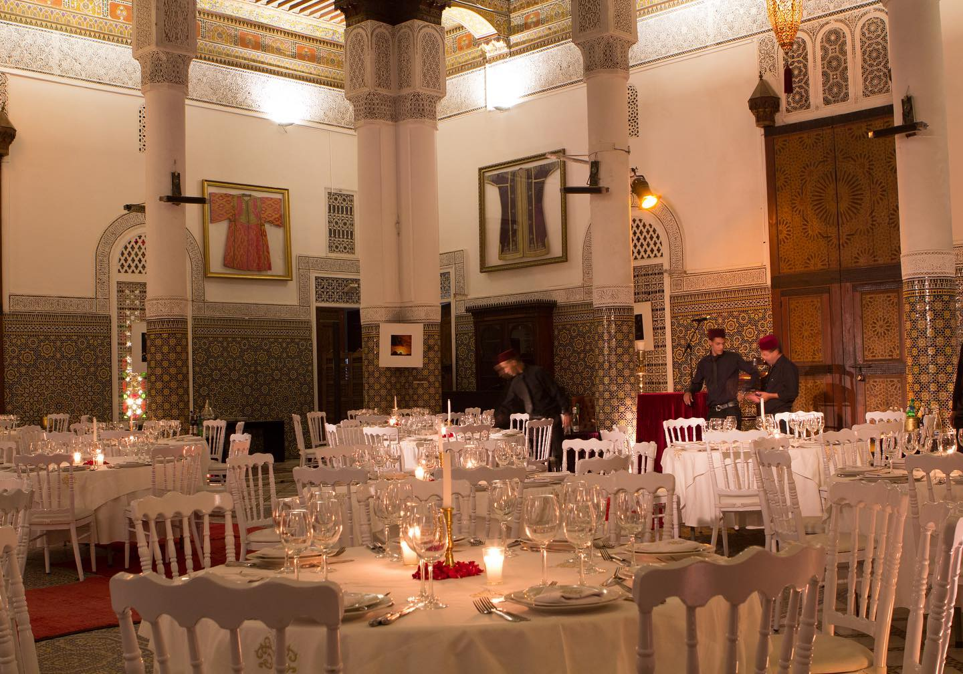

Slide 6
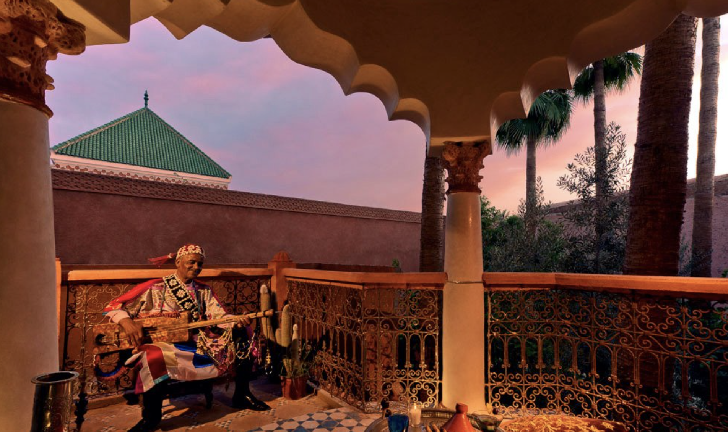
Enjoy delicious homemade and traditional dishes to the sound of music, even outdoors overlooking the garden.

